Slide 1
Agile Roles & Responsibilities

Slide 2
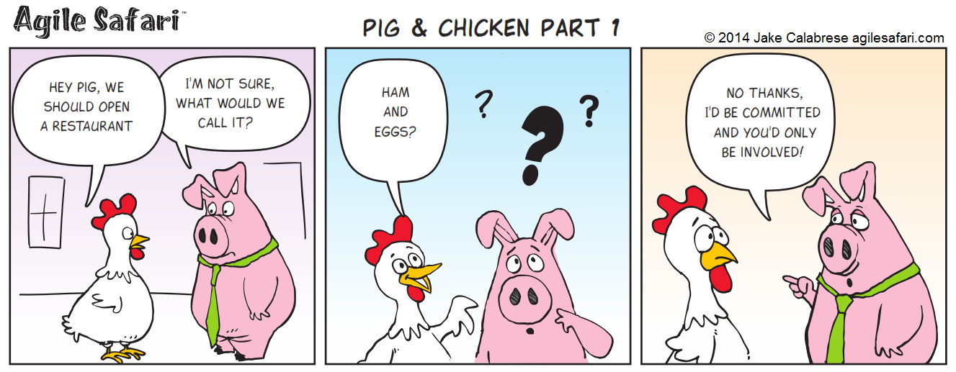
Agile Roles

Slide 3

Agile Roles
Scrum
Product Owner
Development Team
Scrum Master
Kanban
Existing Roles
Agile Coach

Slide 4

Scrum: Product Owner
The Product Owner
One person, not a committee
Has authority to make decisions on behalf of the organization
Understands the product and business direction
Product Owner Responsibilities
Represents the business needs of the organization
Establishes and maintains the overall product vision
Manages and prioritizes the product backlog
Communicates and collaborates with the team to clearly express the product backlog

Slide 5

Scrum: Development Team
The Development Team
Typically made up of 3 to 9 individuals
Self-organizing, which means the team decides how to break up and distribute the work
Cross-functional… There are no titles or specialized areas of responsibility. There may be specific skill sets, but the team is ultimately responsible for delivering incremental functionality
Development Team Responsibilities
Estimates amount of product backlog that can be delivered in a sprint
Decomposes product backlog items into sprint backlog tasks
Turns product backlog items into potentially releasable functionality
Communicates with team on a daily basis

Slide 6

Scrum: Scrum Master
The Scrum Master
One person, not a committee
Understands the principles and practices of Scrum
Not a traditional PM role
Scrum Master Responsibilities
Promotes Scrum within the organization
Ensures the team understands and follows the principles of Scrum
Removes impediments to the team’s progress
Facilitates Scrum events as needed

Slide 7
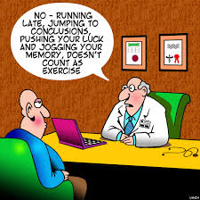
Team Exercise

Slide 8
Scrum: Self Organizing Team Prinicpal
Self Organizing Teams
Successful in a pure agile approach
Run by a scrum master, the team is comprised of responsible, experienced and highly knowledgeable individuals.
Effective teams are highly collaborative, both within the team and with external stakeholders
The team collectively establishes the direction and divides tasks to be completed.
Joint responsibility among team members, means if one person the fails the whole team fails.
Not very scalable to larger projects

Slide 9

Kanban
Kanban doesn’t necessarily prescribe any roles
Start with the roles, responsibilities and job titles that you have now
Identify opportunities to add or remove roles as necessary to minimize cycle time
Everyone becomes a “Change Agent”
Usually have an Agile Coach who facilitates ceremonies like Release Planning, Standups, Process Reviews.
Notes:
Watch the Scrum v. Kanban Video
https://www.youtube.com/watch?v=rIaz-l1Kf8w

